Slide 1

INCIDENCE OF PRIMARY POSTPARTUM HAEMORRHAGE IN OLANREWAJU HOSPITAL
A Quality Improvement Project

Slide 2
Team Members
Balogun Stephen T. (MB; BS, FISQua, SSGB)
Oyinloye Omotayo A. (MB; BS, Associate Fellow ISQua)
Opeyemi Muinat O. (RN)
Onifade Titilayo R. (RN)
Notes:
Talk about the meaning of FISQua, ISQua, SSGB and appreciate the person who introduced you to ISQua

Slide 3
Quality Improvement
What is Quality?
the degree to which health services for individuals and populations increase the likelihood of desired health outcomes and are consistent with current
professional knowledge.
Dimensions of Quality
Safety | Effectiveness
Patient centeredness | Timeliness
Efficiency | equity
Notes:
Safe: avoiding harm to patients from care that is intended to help
Patient-centred: care that is responsive to individual needs and values
Efficient: avoding waste
Effective: services based on scientific knowledge and which produces a clear benefit
Timely: reducing waits and sometimes harmful delay
Equity: providing care that does not vary in quality because of individual status

Slide 4
Six Sigma Method of Quality Improvement
Define
Measure
Analyse
Improve
Input
Control
Tools
Output
Input
Tools
Output
Input
Tools
Output
Tools
Output
Input
Tools
Output
Input
Notes:
Also known as the DMAIC methods. Other methods of quality improvements are the Lean methodology and Total Quality Management

Slide 5
DEFINE
Project Aim
To reduce the incidence of primary postpartum haemorrhage
Project scope
Retrieve delivery records from January 2014
Determine the following parameters:
Number of vaginal deliveries
Number of vaginal deliveries with episiotomy
Number of vaginal deliveries with perineal tear
Number of PPPH cases.
Causes of PPPH in identified cases
Analyze the data
Design improvement parameters
Implement designed plans
Measure improvement overtime and institute a control plan to sustain improvement

Slide 6
DEFINE (Cont’d)
Boundaries
Caesarean deliveries
Pre-term deliveries (gestational age <35 weeks)
Low birth weight babies (birth weight <2 Kg)
Babies delivered before arrival into the Labour room
Patients with abnormal placentation, bleeding diathesis and structural uterine abnormalities
patients with antenatal visits less than 3

Slide 7
DEFINE (Cont’d)
Primary Metrics
a specific decrease in incidence of PPPH
Secondary Metrics
Reduction in the rate of episiotomy
Reduction in the rate of perineal tears
Reduction in the rate of cervical lacerations

Slide 8
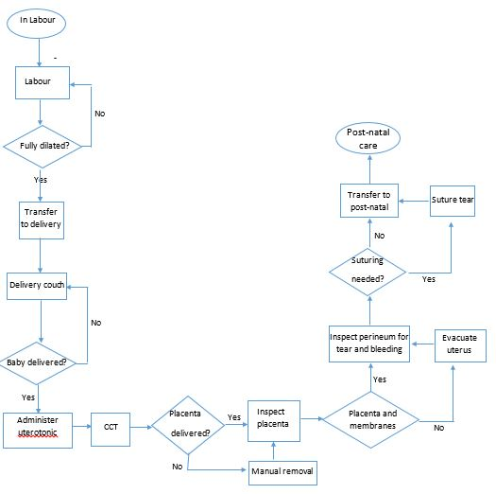
DEFINE (Cont’d)
Notes:
“as is” flow chart where we tried to draw a process map of intrapartum and immediate postpartum experience related to PPPH as it occurs presently

Slide 9
DEFINE (Cont’d)
Benchmarking
Olanrewaju Hospital
Literatures
Prevention of PPPH
In low risk patients
Ergometrine 0.5mg (IM) for patients with normal bp
Oxytocin 10 IU (IM) for patients with elevated bp
In high risk patients
600ug misoprostol PR with either of above.
Treatment of PPPH
Ergometrine 0.5mg (IM) with misoprostol 800 µg PR for patients with normal bp
Oxytocin 10 IU (IM) with misoprostol 800 µg PR for patients with elevated bp
Incidence of PPH
JUTH 0.95%
UITH 4.5%
WHO 2%
ACOG 4-6%
Prevention of PPPH
Oxytocin 10 IU (IM/IV)
Treatment of PPPH
Oxytocin 20-40 IU in N/S
Notes:
High risk patient in this facility that routinely have medications for PPPH prevention are: grand multiparous women, previous PPPH.

Slide 10
MEASURE
Definition of PPPH
blood loss of 500mL or more within the first 24 hours after birth
Period of data collection
from January 2014 to April 2015
Exclusion criteria
Patients outside the scope of the project
Patients with incomplete records
Patients without documentation of estimated blood loss.
"if you can't measure it, then you don't understand it" - Lord Kelvin

Slide 11
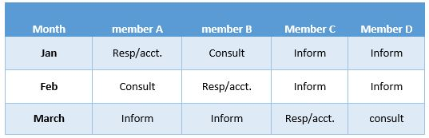
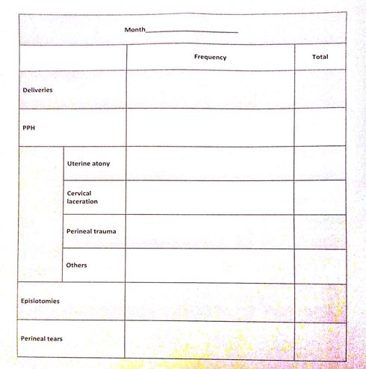
Measure (Cont’d)
Methods of Data Collection
Roles and Responsibility Matrix
Check Sheet
Notes:
The R and R matrix is also called the RACI chart. We went through the case note of each patient noting the total estimated blood loss within the first 24 hours. Some patients had blood loss that were not estimated and could have met the criteria and some had EBL less than 500mL but with significant systemic response.

Slide 12
MEASURE (Cont’d)
Notes:
Episiotomy and perineal tear incidences for April were not collected. All “other” cases of PPPH identified were due to retained products of conception.

Slide 13
ANALYZE
Notes:
About a quarter of the patients had episiotomy compared to WHO recommendation of 2%, and almost have of them had perineal tear.

Slide 14
ANALYZE (Cont’d)

Slide 15
ANALYZE (Cont’d)

Slide 16
ANALYZE (Cont’d)

Slide 17
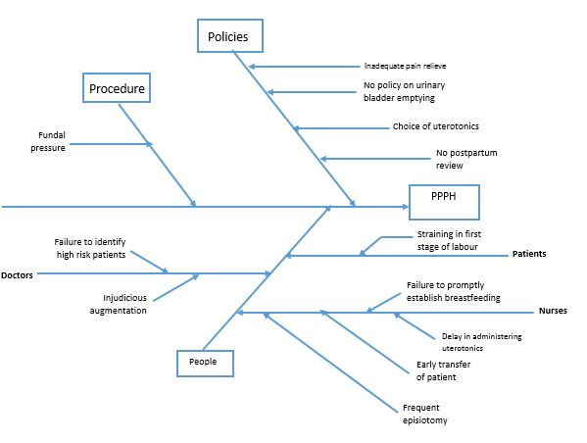
ANALYZE (Cont’d)

Slide 18
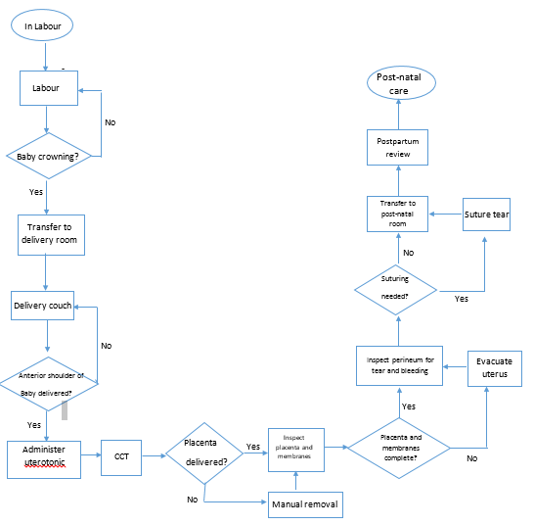
ANALYZE (Cont’d)

Slide 19
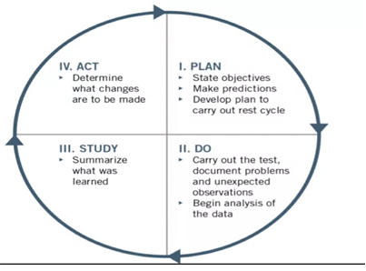
IMPROVE
“Quality improvement is a continuous process and can always be taken a step further”
– Kaoru Ishikawa
PROJECT GOAL (Specific Aim)
The goal of the project is to reduce the incidence of PPPH to <10% by December 2015
Improvement Plan
Plan
Do
Study
Act

Slide 20
IMPROVE (Cont’d)
Phases of Improvement plan
Seminar/ training of staff on:
Adequate antenatal preparation of patients
Labour and delivery
Routine bladder emptying immediate postpartum
Monitoring of postpartum patients.
Review of hospital policy on prevention of primary postpartum haemorrhage.
Develop a protocol for the augmentation of labour
Develop a policy for interval postpartum review.

Slide 21
CONTROL
"all progress is precarious, and the solution to one problem brings us face to face with another" - Dr Martin Luther King jr.
AIM
control the factors that can affect the implemented plans
Measure the effect of the implemented plans on the project
Measurement of Improvement
Outcome Measurement: in terms of clinical, cost and satisfaction outcome
Balancing Measurement: whether the project creates new problems
Process measurement: compliance with the implemented changes

Slide 22
CONTROL (Cont’d)
Control Plan: how the outcome measurements will be measured
Control Chart:
Sustenance of Benefits
Notes:
Sustenance of benefits: incorporation of project outcome into routine practices.

Slide 23
REFERENCES
Incidence of Primary Postpartum Haemorrhage in a Private Hospital in Kwara State, Nigeria, a Quality Improvement Project.
Quality Improvement Made Simple: The Health Foundation
www.globalhealthlearning.org/course/preventing-postpartum-haemorrhage
Six Sigma Green Belt Study Guides
Notes:
Recommend the global health learning for those that are interested.

